Slide 1
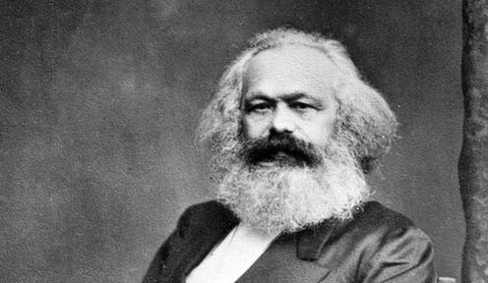
MAX WEBER (1864-1920)

Slide 2
MAX WEBER (1864-1920)
Born on April 21, 1864. Protestant parents, refugees from Catholic persecution. His teachers complained about his lack of respect for their authority.

Slide 3
The Work
Max Weber conceived of sociology as a comprehensive science of social action.
His analysis focused on individual human actors.
Differed from many of his predecessors whose sociology was conceived in social-structural terms
What then, is social action?

Slide 4
Social Action
Behaviour of the individual during interactions as much as the individual attaches subjective meaning.
Sociological analysis would have to examine social action within a context of social interaction, and would have to be interpretive, not viewing people as object just driven by impersonal forces.

Slide 5
Types of Social Action
Four types namely:
Goal-oriented rational action
Value-oriented rational action
Affective action
Traditional action
Modern society requires goal-oriented rational action in its major institutions – pol, econ, edu, health, etc.

Slide 6
Authority
Three types of authority:
Traditional Authority
Charismatic Authority
Rational/Legal Authority

Slide 7
Traditional Authority
Patriarchy
Rule over others without question
Handed down from the past
Given legitimacy by customs
We’ve always done it this way

Slide 8
Charismatic Authority
Worship
Good and bad charisma
Given legitimacy by leaders magical powers, revelations
Do it because you want to appease me

Slide 9
Legal/Rational Authority
Elected leaders
Status allows them to rule us
Electing anchors legitimacy
Central to the rational society
Do it because you accept me as your leader

Slide 10
Bureaucracy
Use of rational principles in formal organizations to rank offices in a hierarchical order with operations characterized by impersonal rules in politics, economy, health, education, etc.
It is a principle of the modern society which ensures large scale planning and predictability.
It has functions and dysfunctions, as noted by Weber.

Slide 11
Features/Characteristics
There are fixed rules, that is, by laws or administrative regulations. There is no room for personal and interpersonal feelings or considerations.
Hierarchy of authority, firmly ordered system of super- and subordination.
Filing written documents, black and white records. Books don’t lie.
Appointment and promotion to offices based on merit and expert training.
There is a clear separation of official life from private life.

Slide 12
Functions of Bureaucracy
Makes large-scale planning possible
Mobilization of resources
Calculability of results
Greater precision
Speed in the operations of officials

Slide 13
Dysfunctions of Bureaucracy
Difficulty in dealing with individual particularities
Leads to depersonalization
Alienation from means of production
Limits human freedom. Iron cage. Prison.
Prevents individual initiative. Non-innovative.
Boredom

Slide 14
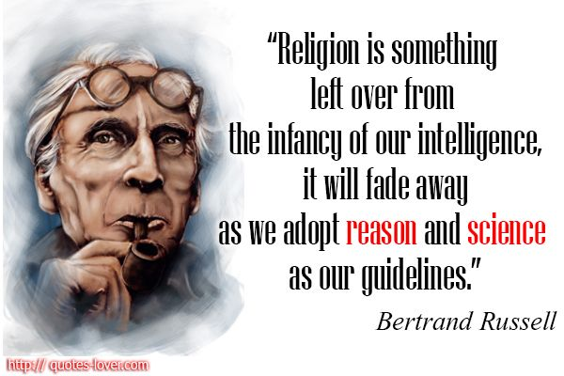
Rationalization and Disenchantment

Slide 15
Rationalization and Disenchantment
The world of modernity has deserted the gods.
The modern man has chased them away with rationalization, calculability and predictability of what in an earlier age had been governed by chance, feeling, passion, and commitment, by personal appeal and personal fealty (fidelity), grace and by the ethics of charismatic heroes.
The more a society modernizes the more the gods shy away from man.

Slide 16
Views on Class, Status and Power
Class: a group of individuals who share a similar position in a capitalist economy. They receive similar economic rewards. A person’s class is basically their market situation. 4 classes as noted by Haralambos and Holborn (2004)
the propertied upper class
the property less white-collar workers
the petty bourgeoisie-the small property owners
the manual working class

Slide 17
Views on Class, Status and Power Cont.
Status: The amount of social honour, respect, recognition, given to a person by virtue of their ‘good lifestyle’ in society. E.g. Castes, Apartheid, Race, Colour, etc.
Power: The ability of a man or group of men to have their will realized even against the resistance of others in a social situation.

